Slide 2
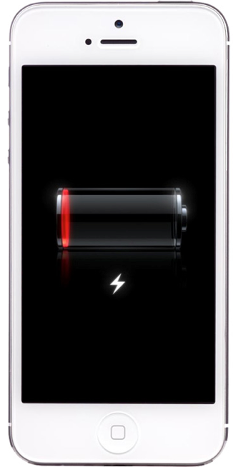
BATTERIES LIMIT PERFORMANCE
Notes:
We all know why we need better batteries, whether it’s cell phones running out of power in the middle of the day, drones that can only fly for 20 minutes at a time, or EVs that don’t go far enough or cost way too much. In particular, developing lower-cost, higher-performance EV batteries would greatly expedite EV adoption and decrease carbon emissions around the world.

Slide 3
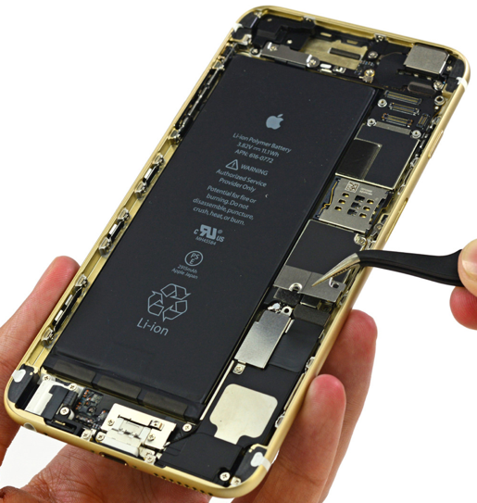
SMALL, LIGHT, STABLE, DURABLE
CUBERG
BATTERY
No potential for
fire or burning.
Feel free to
disassemble,
puncture, crush,
heat, or burn.
Notes:
Cuberg is developing a solid-state battery that can store the same amount of energy in only half the size and half the weight. This can double the battery life of devices. Our battery also offers improved safety and non-flammability, high thermal stability, and improved cycling/thermal/aging durability.

Slide 4

IDEAL 1ST CUSTOMER IDENTIFIED
Oilfield Services Company
“X’s” battery
Cuberg’s battery
Early investor and strategic partner

Slide 5

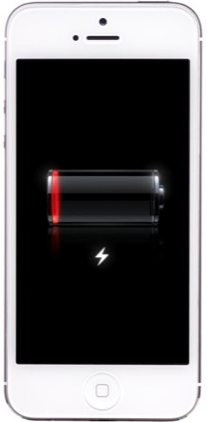
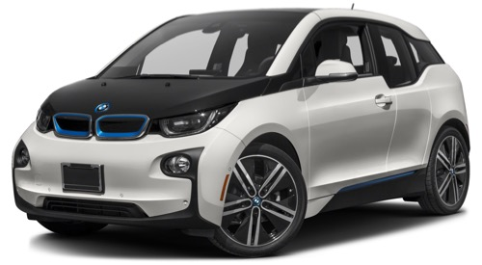
GOING DOWN THE COST CURVE
Relaxed margins
Low volume
Moderate margins
High volume
Stringent margins
Ultra-high volume

Slide 6








DRIVEN AND EXPERIENCED TEAM
ADVISORS
40+ years of executive, startup, and R&D expertise
PARTNERS
Dr. Richard Wang
Prof. Mauro Pasta
Oilfield Services Company

